Slide 1
Greek Civilization
Ibrahim Abou Zahr
202300976
History of Science
Dr. Ali Kaafrani

Slide 2
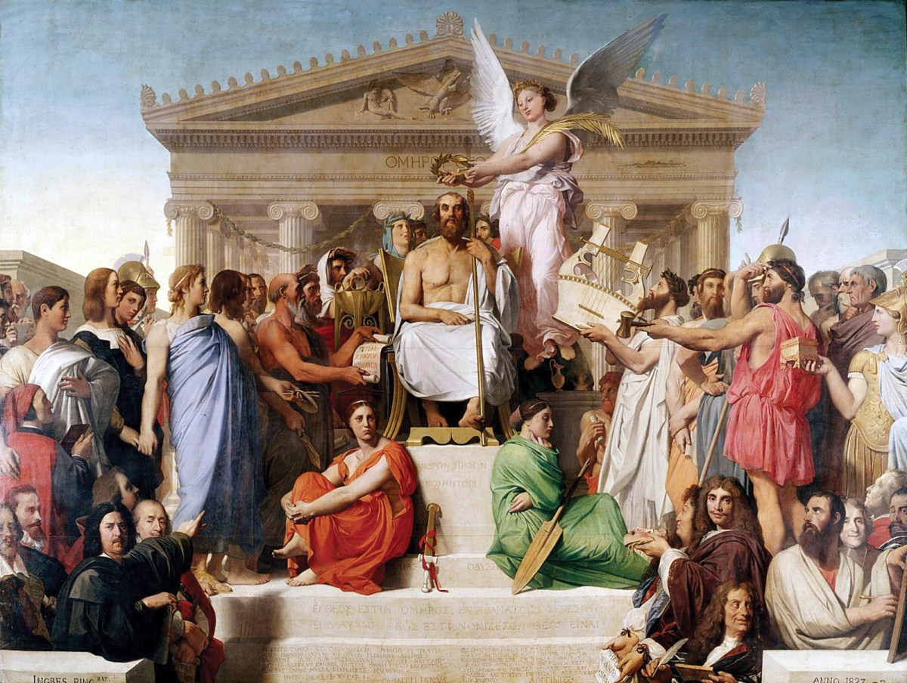
Introduction
The ancient Greek civilization, which thrived from roughly the 8th century BCE to about the 6th century CE, is recognized as one of the most extraordinary and impactful cultures in history. While Greece is frequently lauded for its contributions to philosophy, literature, and democracy, its significance in the history of science is also profound. The Greeks were pioneers in moving away from mythological interpretations of the world to a method of rational investigation grounded in observation, logic, and mathematics. Their quest for knowledge established the intellectual underpinnings for contemporary scientific thought and practices.

Slide 3
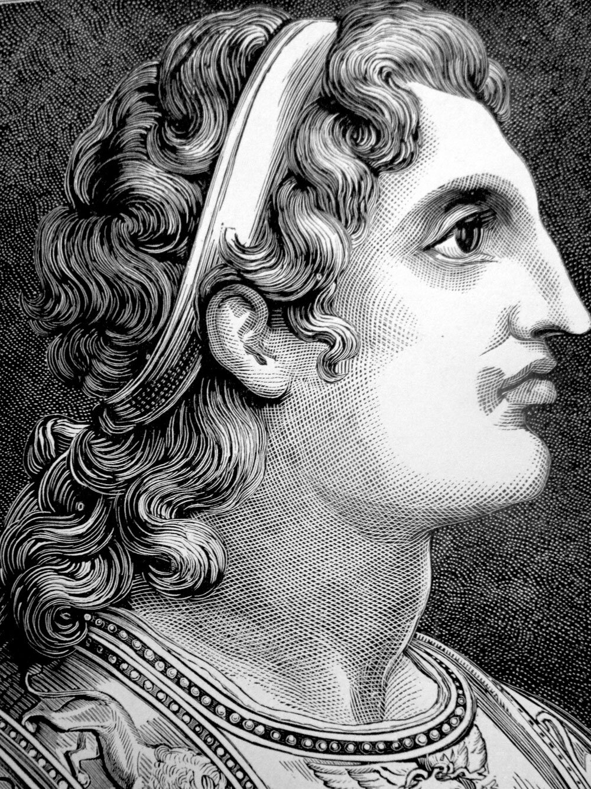
Looking Back at History
Ancient Greece was made up of independent city-states known as poleis, such as Athens, Sparta, and Corinth. Each city-state had its own government and institutions, but they shared a common language, religion, and cultural identity.
The Classical Period (5th–4th century BCE) marked the height of Greek achievements in the arts, philosophy, and science. This period saw the rise of thinkers such as Socrates, Plato, and Aristotle.
Later, under Alexander the Great, Greek culture spread far beyond the borders of mainland Greece. The resulting Hellenistic Period (323–31 BCE) saw Greek science flourish in cities like Alexandria in Egypt, where scholars had access to vast libraries, astronomical instruments, and diverse knowledge from around the known world.

Slide 4
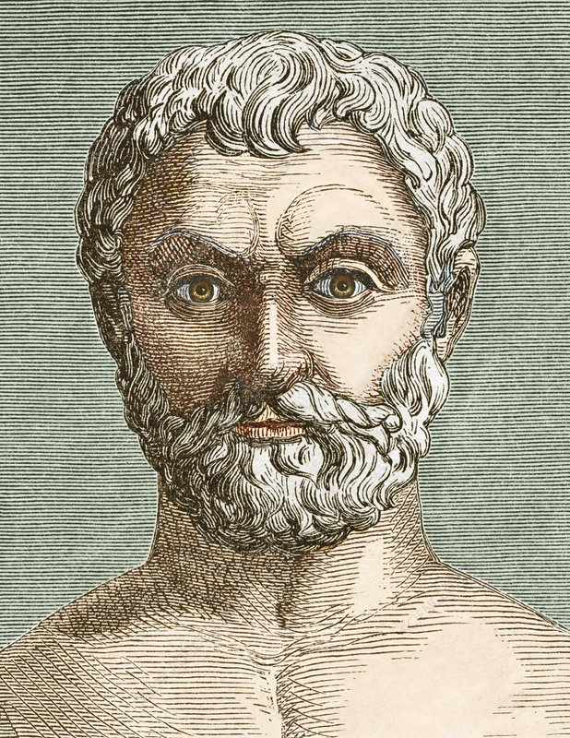
The Birth of Rational Inquiry
One of the defining features of Greek civilization was its transformation from mythological to rational explanations of natural phenomena.
Early Greek thinkers, such as Thales of Miletus (c. 624–546 BCE), began to explain the world in terms of natural elements rather than supernatural gods. Thales proposed that water was the essential substance underlying all matter. His approach marked a radical departure from traditional myth-based worldviews.
This new way of thinking spread and evolved. Greek philosophers and scientists began to value logic, observation, and critical analysis. They categorized knowledge, sought causes, developed hypotheses, and even debated theories, long before the formal development of the scientific method in the modern era.

Slide 5
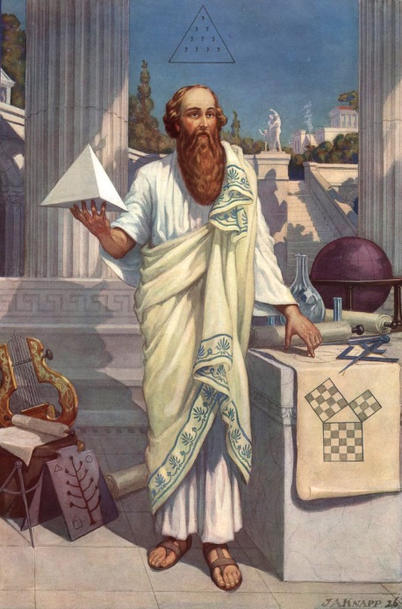
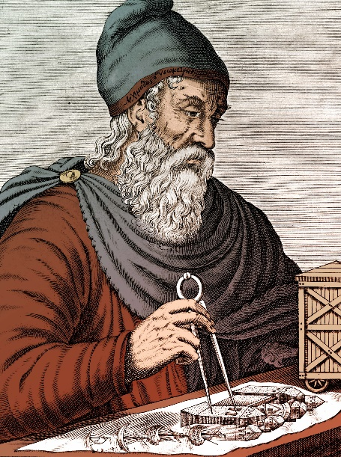
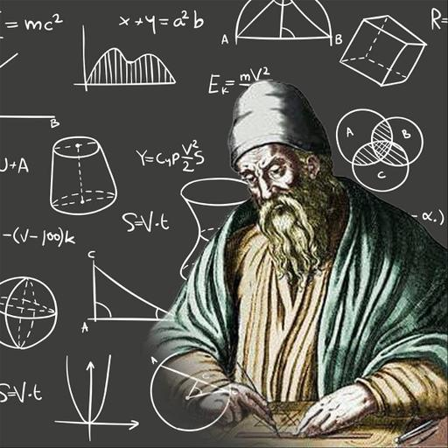
Mathematics
Pythagoras (c. 570–495 BCE) founded a school that explored the relationship between numbers and nature. His famous Pythagorean Theorem is still fundamental in geometry. Pythagoras and his followers believed that reality could be explained through mathematical relationships and harmony.
Euclid (c. 300 BCE), often called the “Father of Geometry,” wrote a comprehensive textbook called "Elements", which systematically organized the mathematical knowledge of his time.
Archimedes (c. 287–212 BCE), another towering figure, made significant contributions to both pure and applied mathematics. He developed formulas to calculate areas and volumes, and even approximated pi with remarkable accuracy. Archimedes is also credited with discovering principles of buoyancy and levers, applying math to real-world mechanical problems.

Slide 6
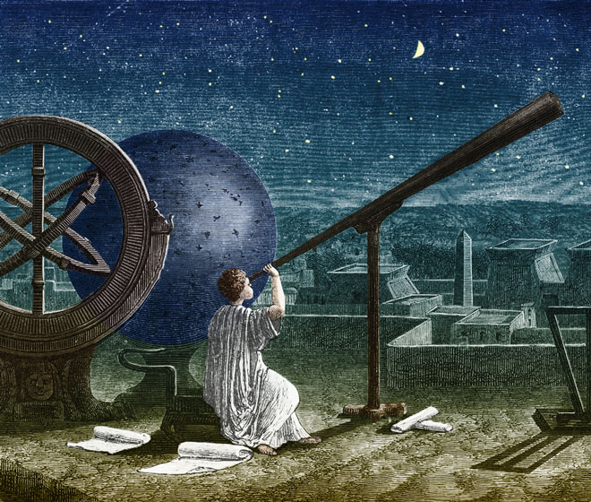
Astronomy
Anaximander (c. 610–546 BCE) suggested that the Earth floated freely in space without support, a revolutionary idea at the time. He also created one of the earliest known maps of the world.
Aristarchus of Samos (c. 310–230 BCE) proposed a heliocentric model of the solar system, arguing that the Earth and planets revolved around the sun. This idea was not widely accepted in his time but would later influence Copernicus and the development of modern astronomy.
Hipparchus (c. 190–120 BCE) is often considered the founder of trigonometry. He created the first accurate star catalog and discovered the precession of the equinoxes, a subtle movement in the Earth's rotation.
Ptolemy (c. 100–170 CE) compiled Greek astronomical knowledge into the Almagest, a monumental work that described a geocentric universe with complex planetary orbits. Though his model was eventually disproved, it dominated astronomical thinking for over 1,400 years.

Slide 7
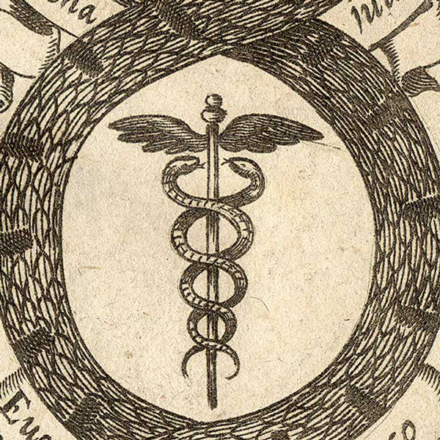
Medicine
Hippocrates (c. 460–370 BCE), often referred to as the Father of Medicine, rejected supernatural explanations for disease. He believed that illnesses had natural causes and could be treated through observation and care. His Hippocratic Corpus contains some of the earliest medical texts, and the Hippocratic Oath still serves as a moral guideline for physicians today.
Greek medicine was based on the theory of the four humors: blood, phlegm, yellow bile, and black bile. Health was thought to depend on their balance, and treatments aimed to restore this equilibrium.
Subsequently, Galen (c. 129–216 CE), a Greek doctor in the Roman Empire, expanded on the theories of Hippocrates. He performed numerous dissections on animals, creating comprehensive anatomical theories that shaped Western medicine for more than a thousand years.

Slide 8
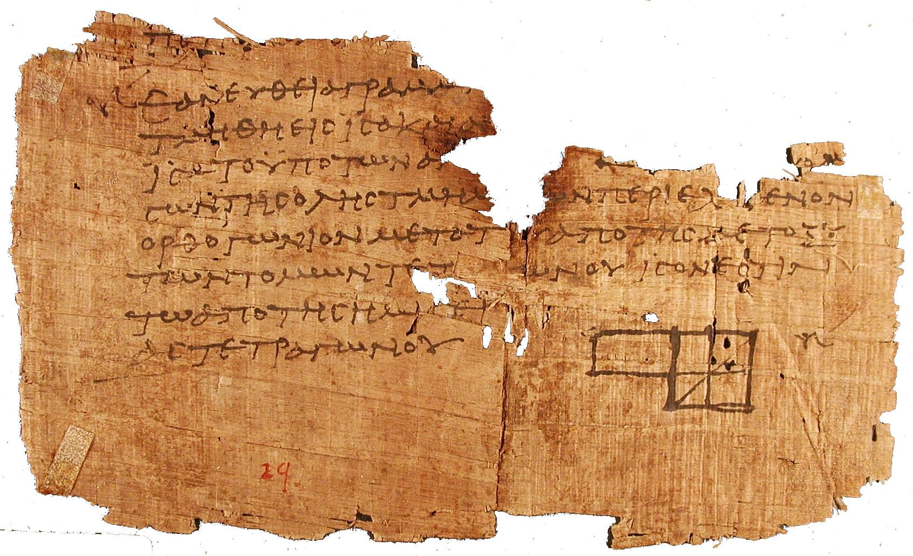
Legacy and Influence
The scientific ideas developed in ancient Greece did not disappear. Instead, they were preserved and expanded upon during the Islamic Golden Age, and later rediscovered during the European Renaissance, fueling advancements in astronomy, medicine, and physics.

Slide 9
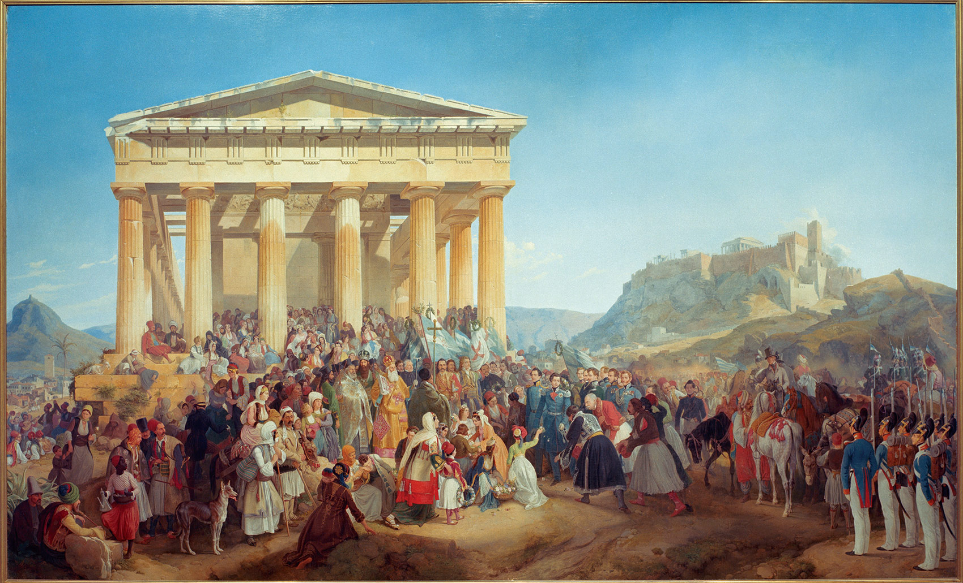
Greek Science & Future Significance
The Greek civilization stands as a cornerstone in the history of science.
The Greek scientific legacy laid the groundwork for the Renaissance and the development of the modern scientific method.

Slide 10
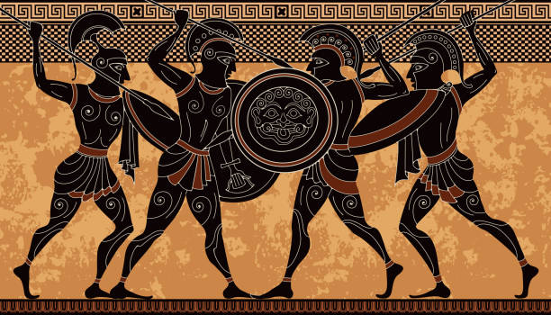
Conclusion
The Greek civilization was a crucial part in history especially in it’s strong contribution to science it all it’s fields. Its thinkers dared to ask difficult questions and build systems of knowledge based on reason, observation, and mathematics. Their contributions in fields like mathematics, astronomy and medicine laid the groundwork for centuries of scientific advancement. Today, we still study and admire the brilliance of Greek science, not only for the knowledge it produced but for the way it transformed how we think about the world.

Slide 11
References
https://archive.org/details/presocraticphilo0000kirk_w5t7
https://www.britannica.com/science/history-of-science/Greek-science
https://www.ducksters.com/history/ancient_greece/science_and_technology.php
https://galileoandeinstein.phys.virginia.edu/lectures/thales.html
https://www.worldhistory.org/Greek_Science/

